Slide 1
SCHEDULING

Slide 2
SCHEDULING
Scheduling the project tasks is an important project planning activity.
The scheduling problem, in essence, consists of deciding which tasks would be taken up when and by whom.
Once a schedule has been worked out and the project gets underway, the project manager monitors the timely completion of the tasks and takes any corrective action that may be necessary whenever there is a chance of schedule slippage.

Slide 3
SCHEDULING
In order to schedule the project activities, a software project manager needs to do the following:
1.Identify all the major activities that need to be carried out to complete the project.
2.Break down each activity into tasks.
3.Determine the dependency among different tasks.
4.Represent the information in the form of an activity network.
5.Establish the estimates for the time durations necessary to complete the tasks.

Slide 4
SCHEDULING
6.Determine task starting and ending dates from the information represented in the activity network.
7.Determine the critical path. A critical path is a chain of tasks that determines the duration of the project.
8.Allocate resources to tasks.

Slide 5
SCHEDULING
The first step in scheduling a software project involves identifying all the activities necessary to complete the project.
A good knowledge of the intricacies of the project and the development process helps the managers to effectively identify the important activities of the project.
Next, the activities are broken down into a logical set of smaller activities (subactivities).
The smallest subactivities are called tasks which are assigned to different developers.

Slide 6
SCHEDULING
The smallest unit of work activities that are subject to management planning and control are called tasks.
A project manager breakdowns the tasks systematically by using the work breakdown structure.
After the project manager has broken down the activities into tasks, he has to find the dependency among the tasks.
Dependency among the different tasks determines the order in which the different tasks would be carried out.
If a task A requires the results of another task B, then task A must be scheduled after task B and A is said to be dependent on B.

Slide 7
SCHEDULING
In general, the task dependencies define a partial ordering among tasks.
That is, each tasks may precede a subset of other tasks, but some tasks might not have any precedence ordering defined between them (called concurrent task ).
The dependency among the activities are represented in the form of an activity network.
Once the activity network representation has been worked out, resources are allocated to each activity.
Resource allocation is typically done using a Gantt chart. After resource allocation is done, a project evaluation and review technique (PERT) chart representation is developed.
The PERT chart representation is useful to a project manager to carry out project monitoring and control.

Slide 8
Work Breakdown Structure
Work breakdown structure (WBS) is used to recursively decompose a given set of activities into smaller activities.
Tasks are the lowest level work activities in a WBS hierarchy. They also form the basic units of work that are allocated to the developer and scheduled

Slide 9
Work Breakdown Structure
First, let us understand why it is necessary to break down project activities into tasks.
Once project activities have been decomposed into a set of tasks using WBS, the time frame when each activity is to be performed is to be determined.
The end of each important activity is called a milestone.
The project manager tracks the progress of a project by monitoring the timely completion of the milestones.
If he observes that some milestones start getting delayed, he carefully monitors and controls the progress of the tasks, so that the overall deadline can still be met.

Slide 10
Work Breakdown Structure
WBS provides a notation for representing the activities, sub-activities, and tasks needed to be carried out in order to solve a problem.
Each of these is represented using a rectangle (see below mentionFigure ).
The root of the tree is labelled by the project name.
Each node of the tree is broken down into smaller activities that are made the children of the node.
To decompose an activity to a sub-activity, a good knowledge of the activity can be useful.

Slide 11
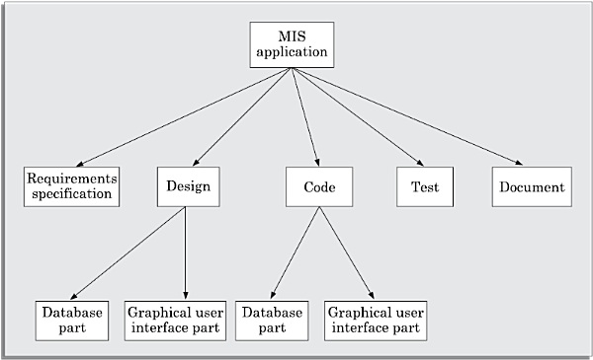
Work Breakdown Structure
Folllowing figure represents the WBS of a management information system (MIS) software
Fig:Work breakdown structure of an MIS problem.

Slide 12
How long to decompose?
The decomposition of the activities is carried out until any of the following is satisfied:
A leaf-level subactivity (a task) requires approximately two weeks to develop.
Hidden complexities are exposed, so that the job to be done is understood and can be assigned as a unit of work to one of the developers.
Opportunities for reuse of existing software components is identified.

Slide 13
Activity Networks
An activity network shows the different activities making up a project, their estimated durations, and their interdependencies.
Two equivalent representations for activity networks are possible and are in use:
1. Activity on Node (AoN)
2.Activity on Edge (AoE)

Slide 14
Activity on Node (AoN)
In this representation, each activity is represented by a rectangular (some use circular) node and the duration of the activity is shown alongside each task in the node.
The inter-task dependencies are shown using directional edges (see following Figure ).

Slide 15
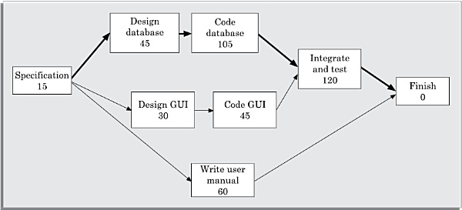
Activity network representation of the MIS problem

Slide 16
Activity on Edge (AoE)
In this representation tasks are associated with the edges. The edges are also annotated with the task duration. The nodes in the graph represent project milestones.
Activity networks were originally represented using activity on edge (AoE) representation.
However, later activity on node (AoN) has become popular since this representation is easier to understand and revise.

Slide 17
Activity Networks
Managers can estimate the time durations for the different tasks in several ways.
One possibility is that they can empirically assign durations to different tasks.
This however may not be such a good idea, because software developers often resent such unilateral decisions.
However, some managers prefer to estimate the time for various activities themselves.
They believe that an aggressive schedule would motivate the developers to do a better and faster job.
On the other hand, careful experiments have shown that unrealistically aggressive schedules not only cause developers to compromise on intangible quality aspects, but also cause greater schedule delays compared to the other approaches.
A possible alternative is to let each developer himself estimate the time for an activity he would be assigned to. This approach can help to accurately estimate the task durations without creating undue schedule pressures.

Slide 18
Example
Determine the Activity network representation for the MIS development project . Assume that the manager has determined the tasks to be represented from the work breakdown structure of previous figure , and has determined the durations and dependencies for each task as shown in Table below.

Slide 19
Example
T | able : | Project Parameters Computed from Activity Network
Task | Number | Task | Duration | Dependent on |  |  |  | Tasks
T1 |  | Specification | 15 | –
T2 |  | Design database | 45 | T | 1
T3 |  | Design GUI | 30 | T | 1
T4 |  | Code database | 105 | T | 2
T5 |  | Code GUI part | 45 | T | 3
T6 |  | Integrate and test | 120 | T | 4 | andT | 5
T7 |  | Write user manual | 60 | T | 1
Answer: The activity network representation has been shown in previous slide in figure .

Slide 20
Critical Path Method (CPM)
A path in the activity network graph is any set of consecutive nodes and edges in this graph from the starting node to the last node. A critical path consists of a set of dependent tasks that need to be performed in a sequence and which together take the longest time to complete.
CPM is an algorithmic approach to determine the critical paths and slack times for tasks not on the critical paths involves calculating the following quantities:

Slide 21
Critical Path Method (CPM)
Minimum time (MT): It is the minimum time required to complete the project. It is computed by determining the maximum of all paths from start to finish.
Earliest start (ES):It is the time of a task is the maximum of all paths from the start to this task. The ES for a task is the ES of the previous task plus the duration of the preceding task.
Latest start time (LST): It is the difference between MT and the maximum of all paths from this task to the finish. The LST can be computed by subtracting the duration of the subsequent task from the LST of the subsequent task.

Slide 22
Critical Path Method (CPM)
Earliest finish time (EF): The EF for a task is the sum of the earliest start time of the task and the duration of the task.
Latest finish (LF): LF indicates the latest time by which a task can finish without affecting the final completion time of the project. A task completing beyond its LF would cause project delay. LF of a task can be obtained by subtracting maximum of all paths from this task to finish from MT.
Slack time (ST): The slack time (or float time) is the total time that a task may be delayed before it will affect the end time of the project. The slack time indicates the ”flexibility” in starting and completion of tasks. ST for a task is LS-ES and can equivalently be written as LF-EF.

Slide 23
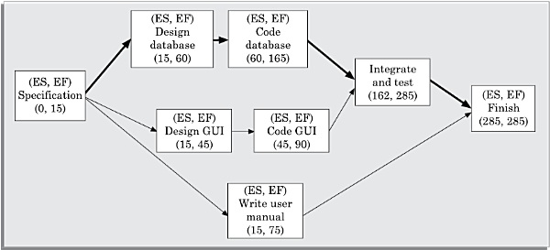
Example : Use the Activity network of Figure slide 15 to determine the ES and EF for every task for the MIS problem .
Answer: The activity network with computed ES and EF values has been shown in following figure.
Figure : AoN for MIS problem with (ES,EF).

Slide 24
Example: Use the Activity network of following figure to determine the LS and LF for every task for the MIS problem.
The activity network with computed LS and LF values has been shown in following figure .
Thus any path whose duration equals MT is a critical path.
Note that, there can be more than one critical path for a project.
Tasks which fall on the critical path should receive special attention by both the project manager and the personnel assigned to perform those tasks.
One way is to draw the critical paths with a double line instead of a single line.
CPM can be used to determine the minimum estimated duration of a project and the slack times associated with various non-critical tasks.

Slide 25
Critical Path Method (CPM)
The critical path may change as the project progresses.
This may happen when tasks are completed either behind or ahead of schedule.
The project parameters for different tasks for the MIS problem can be computed as follows:
1.Compute ES and EF for each task. Use the rule: ES is equal to the largest EF the immediate predecessors.
2.Compute LS and LF for each task. Use the rule: LF is equal to
the smallest LS of the immediate successors.
3.Compute ST for each task. Use the rule: ST=LF-EF

Slide 26
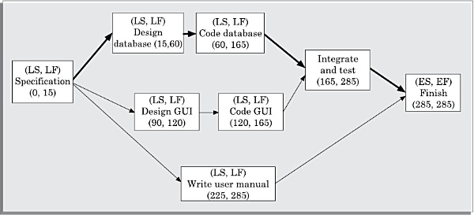
Figure : AoN of MIS problem with (LS,LF).

Slide 27
Critical Path Method (CPM)
In Figure of slide 23 and 26, we show computation of (ES,EF) and (LS,LF) respectively.
From this project parameters for different tasks for the MIS problem have been represented in following Table.
The critical paths are all the paths whose duration equals MT. The critical path in figure slide number 15 is shown using a thick arrows.

Slide 28
Table : Project Parameters Computed From Activity Network
Task | ES | EF | LS | LF | ST
Specification | 0 | 15 | 0 | 15 | 0
Design data base | 15 | 60 | 15 | 60 | 0
Design GUI part | 15 | 45 | 90 | 120 | 75
Code data base | 60 | 165 | 60 | 165 | 0
Code GUI part | 45 | 90 | 120 | 165 | 75
Integrate and test | 165 | 285 | 165 | 285 | 0
Write user manual | 15 | 75 | 225 | 285 | 210

Slide 29
PERT Charts
The activity durations computed using an activity network are only estimated duration.
It is therefore not possible to estimate the worst case (pessimistic) and best case (optimistic) estimations using an activity diagram. Since, the actual durations might vary from the estimated durations, the utility of the activity network diagrams are limited.
The CPM can be used to determine the duration of a project, but does not provide any indication of the probability of meeting that schedule.

Slide 30
PERT Charts
Project evaluation and review technique (PERT) charts are a more sophisticated form of activity chart.
Project managers know that there is considerable uncertainty about how much time a task would exactly take to complete.
The duration assigned to tasks by the project manager are after all only estimates.
Therefore, in reality the duration of an activity is a random variable with some probability distribution.
In this context, PERT charts can be used to determine the probabilistic times for reaching various project mile stones, including the final mile stone.

Slide 31
PERT Charts
PERT charts like activity networks consist of a network of boxes and arrows.
The boxes represent activities and the arrows represent task dependencies.
A PERT chart represents the statistical variations in the project estimates assuming these to be normal distribution.
PERT allows for some randomness in task completion times, and therefore provides the capability to determine the probability for achieving project milestones based on the probability of completing each task along the path to that milestone.

Slide 32
PERT Charts
Each task is annotated with three estimates:
Optimistic (O): The best possible case task completion time.
Most likely estimate (M): Most likely task completion time.
Worst case (W): The worst possible case task completion time.
The optimistic (O) and worst case (W) estimates represent the extremities of all possible scenarios of task completion.
The most likely estimate (M) is the completion time that has the highest probability.

Slide 33
PERT Charts
The three estimates are used to compute the expected value of the standard deviation.
It can be shown that the entire distribution lies between the interval (M – 3* ST ) and (M + 3 *ST ), where ST is the standard deviation.
From this it is possible to show that—The standard deviation for a task ST = (P – O)/6.
The mean estimated time is calculated as ET = (O + 4M + W )/6.
Since all possible completion times between the minimum and maximum duration for every task has to be considered, there can be many critical paths, depending on the various permutations of the estimates for each task.

Slide 34
PERT Charts
This makes critical path analysis in PERT charts very complex.
A critical path in a PERT chart is shown by using thicker arrows.
The PERT chart representation of the MIS problem is shown in following figure.

Slide 35
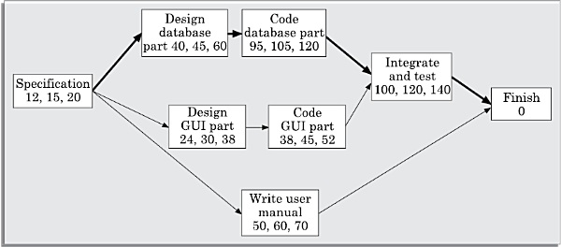
PERT Charts
Figure : PERT chart representation of the MIS problem.

Slide 36
Gantt Charts
Gantt chart has been named after its developer Henry Gantt.
A Gantt chart is a form of bar chart. The vertical axis lists all the tasks to be performed.
The bars are drawn along the y-axis, one for each task. Gantt charts used in software project management are actually an enhanced version of the standard Gantt charts.
In the Gantt charts used for software project management, each bar consists of a unshaded part and a shaded part.
The shaded part of the bar shows the length of time each task is estimated to take.

Slide 37

Gantt Charts
The unshaded part shows the slack time or lax time.
The lax time represents the leeway or flexibility available in meeting the latest time by which a task must be finished.
A Gantt chart representation for the MIS problem is shown in figure.

Slide 38
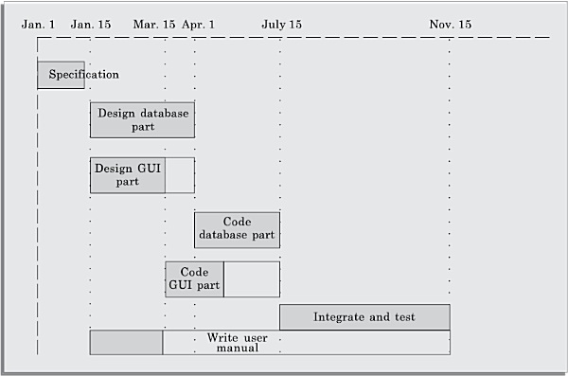
Gantt Chart
Figure : Gantt chart representation of the MIS problem.

Slide 39
Advantages of Gantt Chart
Gantt charts are useful for resource planning (i.e. allocate resources to activities).
The different types of resources that need to be allocated to activities include staff, hardware, and software.
Gantt chart representation of a project schedule is helpful in planning the utilisation of resources, while PERT chart is useful for monitoring the timely progress of activities.
Also, it is easier to identify parallel activities in a project using a PERT chart.
Project managers need to identify the parallel activities in a project for assignment to different developers.

Slide 40
Any Question

Slide 41
Thank you

